Slide 1

HR ANALYTICS PRESENTATION
GROUP - 6

Slide 2




Project analysis slide 2
HR Analytics
PERFORMANCE
ATTRITION
KPIs
SATISFACTION
REVENUE
SALARY HIKE
EXPENSES
GROUP - 6

Slide 3



Project analysis slide 3
HR Analytics
EMPLOYEE ANALYSIS
ATTRITION ANALYSIS
FINANCIAL ANALYSIS
SATISFACTION ANALYSIS
PERFORMANCE ANALYSIS
This section provides a brief overview of the analysis of the Employees, including department-wise, gender-wise, and total count.
A summary of the analysis of the employees who departed the company is given in this section.
An overview of the financial analysis is given in this part, including information on income, expenses, salary hikes, and other topics.
A synopsis of the analysis of the job, work, and relationship satisfaction of Employees is given in this part.
The analysis of the Employee's performance is summarized in this section.

Slide 4
Project analysis slide 6
EMPLOYEE ANALYSIS
Total number of employees by department wise.
39
Emp Average Age
Hardware
8169
HR
8412
R & D
8319
The average age of the company's workforce is 39 years old.
Sales
8453
Software
8336
Support
8305
50000
TOTAL EMPLOYEES
There are fifty thousand people working for the company.

Slide 5
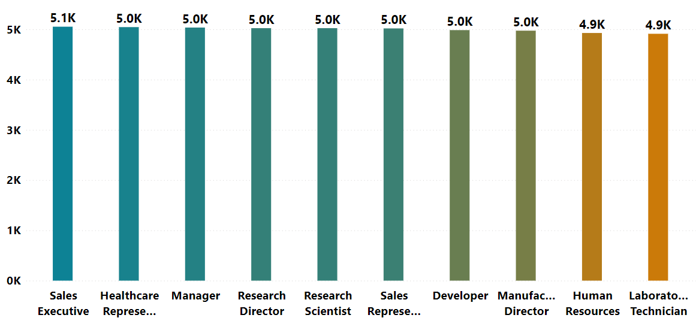
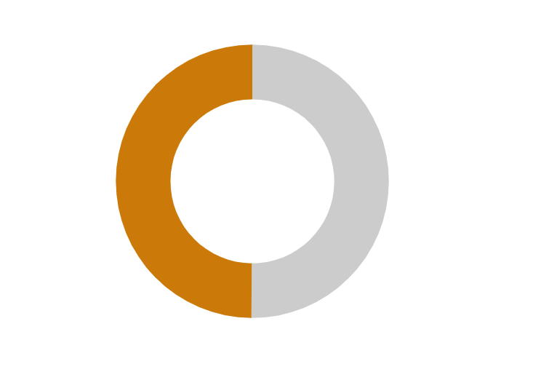
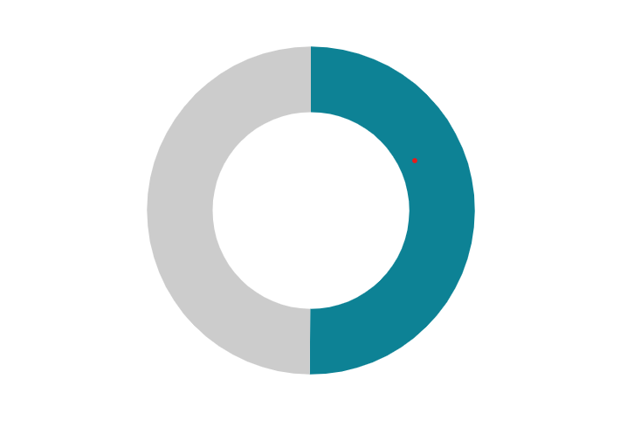
Project analysis slide 5
EMPLOYEE ANALYSIS
ENTIRE WORKFORCE BY DESIGNATION
24941
(49.88%)
Female Count Information
Male Count Information
25059
(50.12%)
ACTIVE EMPLOYEES
EX - EMPLOYEES
AVERAGE AGE AT COMPANY
24,895
25,105
11 Years
This section lists the current workers for the company.
Total number of workers who have departed the company.
This represents the Employee’s average age at company.

Slide 6
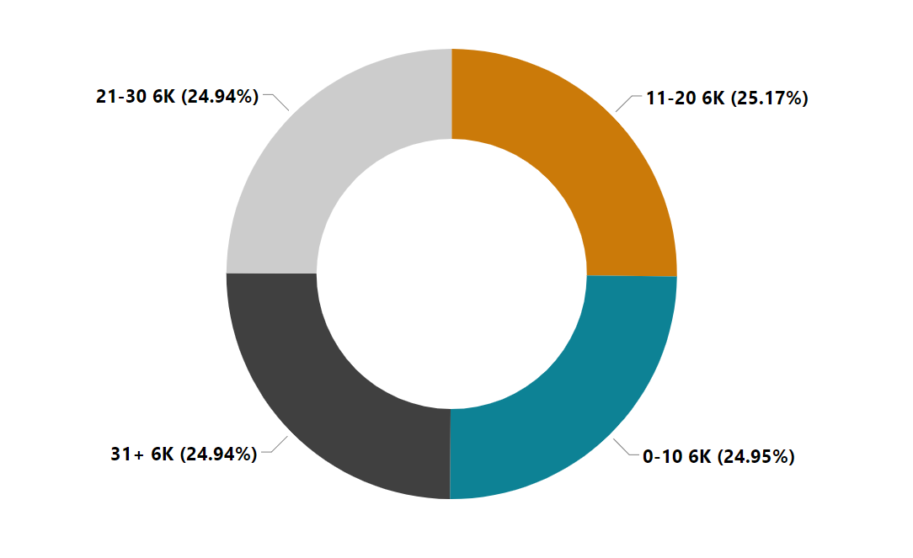
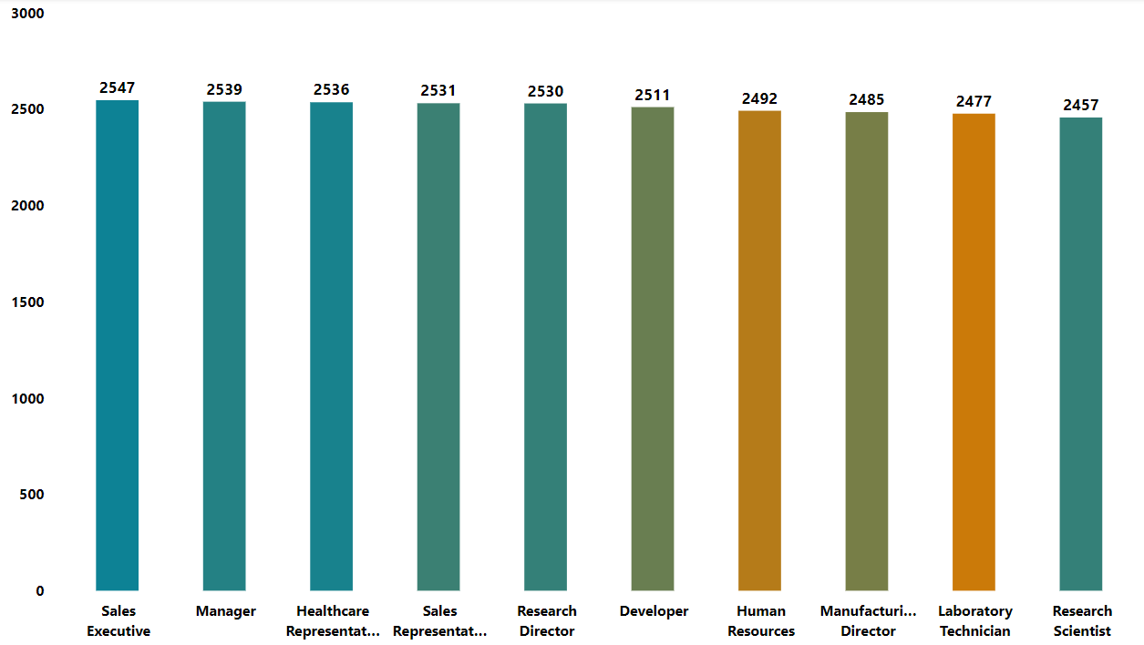
Project analysis slide 5
ATTRITION ANALYSIS
ATTRITION RATE
Number of former employees and their percentage of total workers aged 31 and up.
50.21%
25105
This represents the attrition rate for those who departed the Company.
EX-WORKERS BY DESIGNATION
EX - EMPLOYEES
25,105
Total number of workers who have departed the company.

Slide 7
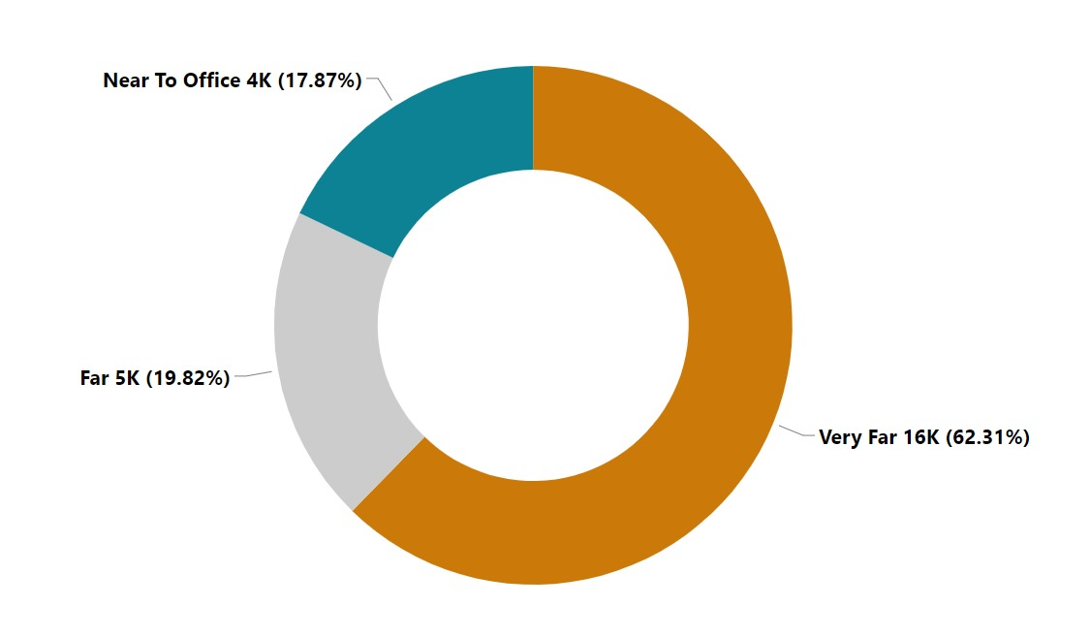
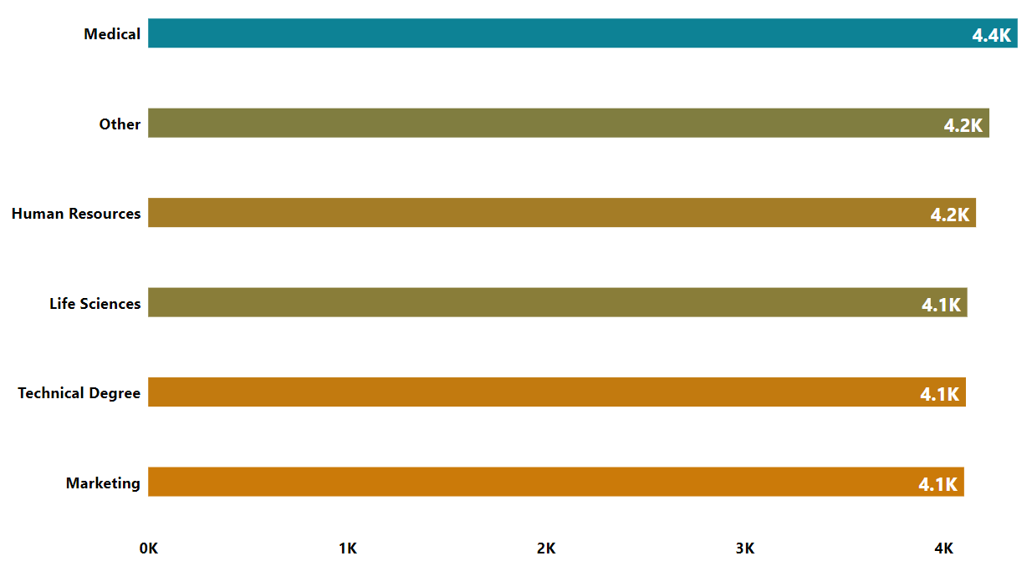
Project analysis slide 5
ATTRITION ANALYSIS
Former Workers by Distance and Education
This section displays Percentage and the number of former employees by distance from the workplace.
25105
EX - Workers by Education Sector
EX - EMPLOYEES
25,105
Total number of workers who have departed the company.

Slide 8
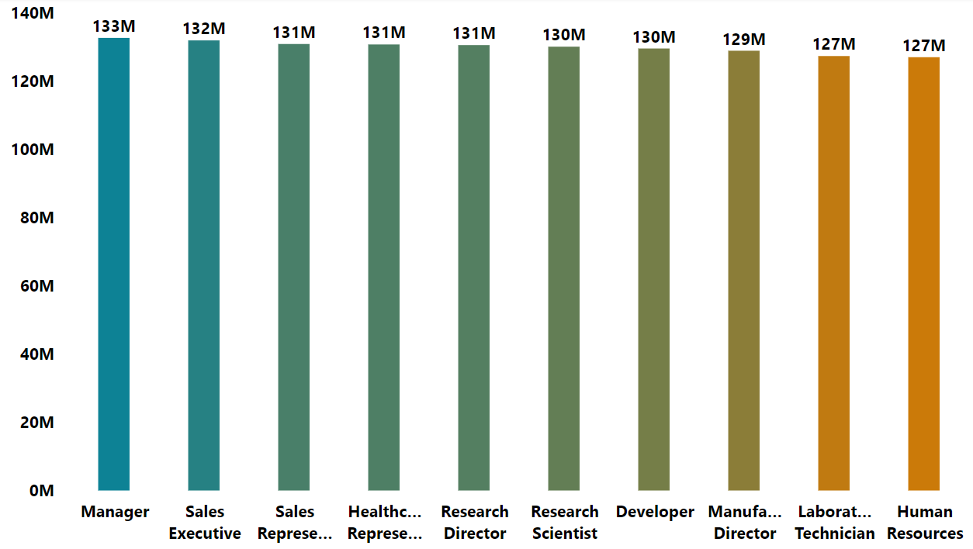
Project analysis slide 10
FINANCIAL ANALYSIS
TOTAL INCOME
This section displays the company's total income as well as income broken down by position.
1,301M
MONTHLY INCOME BY POSITION
MAXIMUM INCOME
50,999
MINIMUM INCOME
1,001

Slide 9
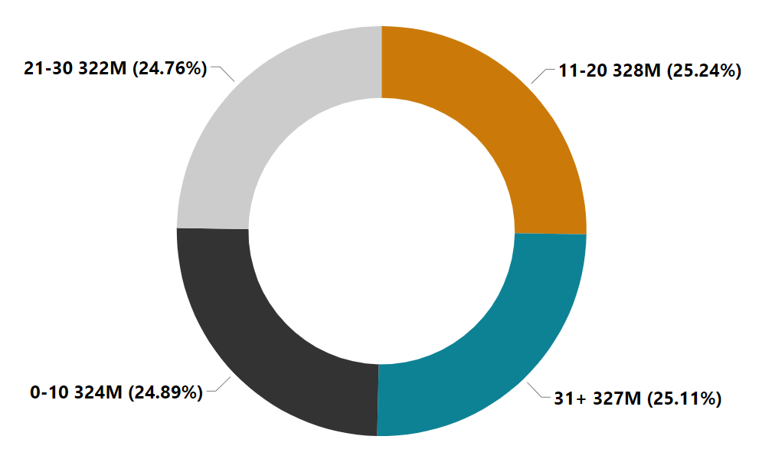
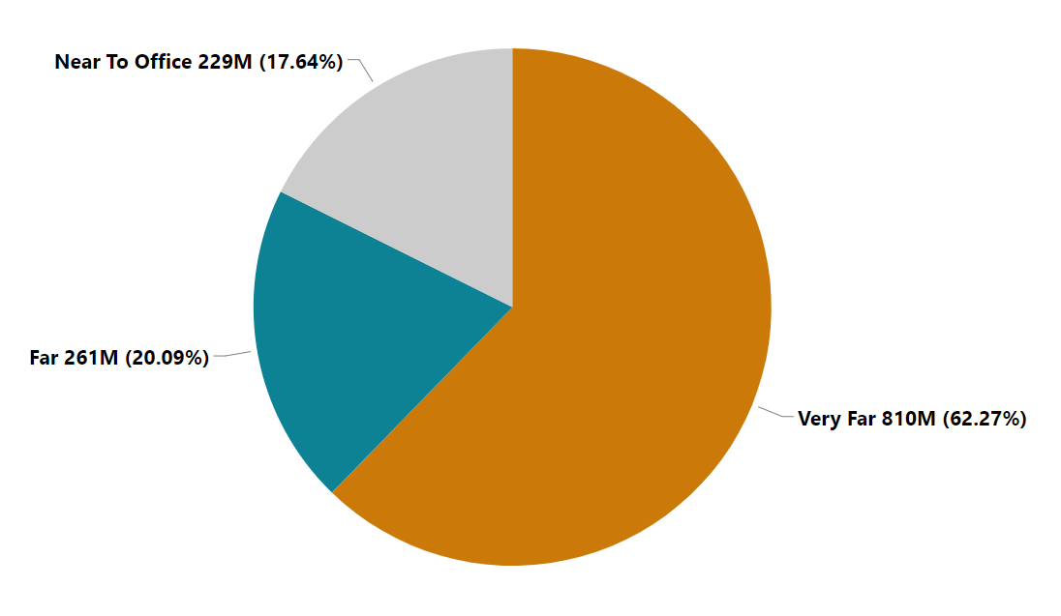
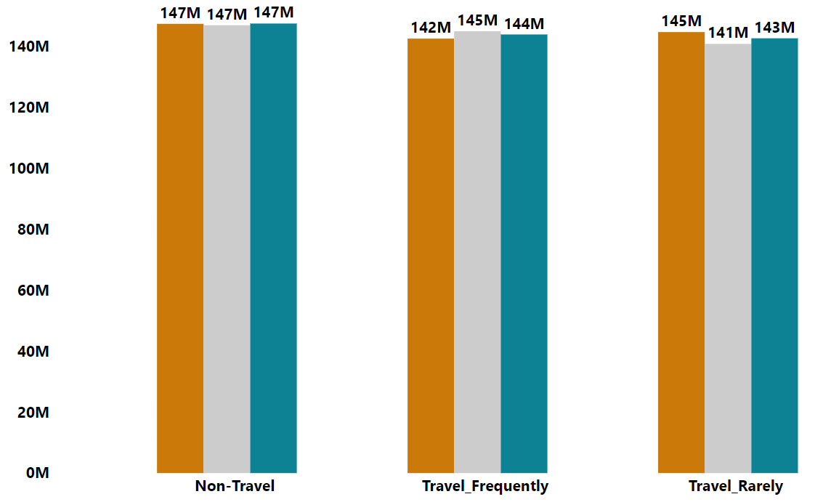
Project analysis slide 10
FINANCIAL ANALYSIS
MONTHLY INCOME BY WORKING YEARS
MONTHLY INCOME BY DISTANCE
This section displays Percentage and Total Monthly Income by Working Years and Distance
MONTHLY INCOME BY MARIATL/TRAVEL
Total Monthly Income broken down by Travel and Marital Status is shown in this section.
Orange color indicates divorce, grey color indicates married, and blue color indicates single status.

Slide 10
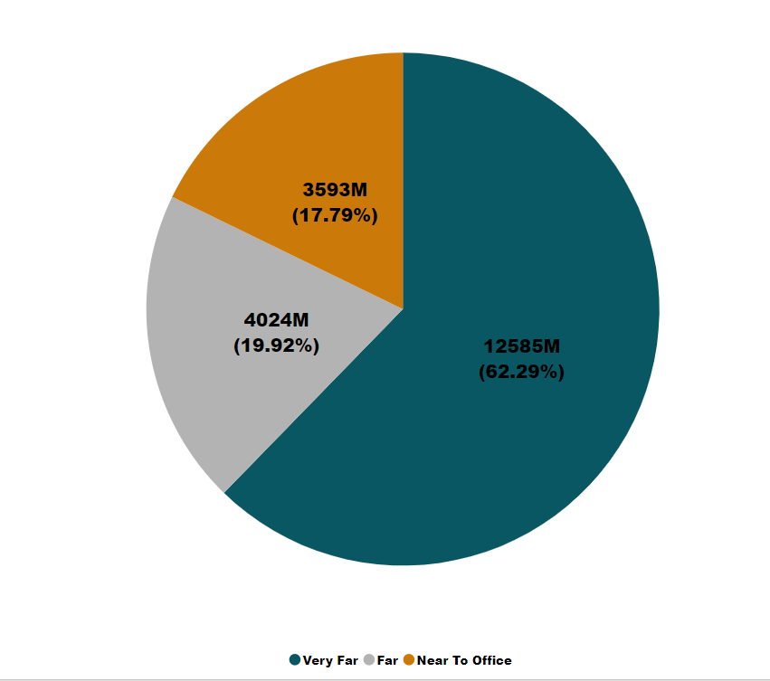
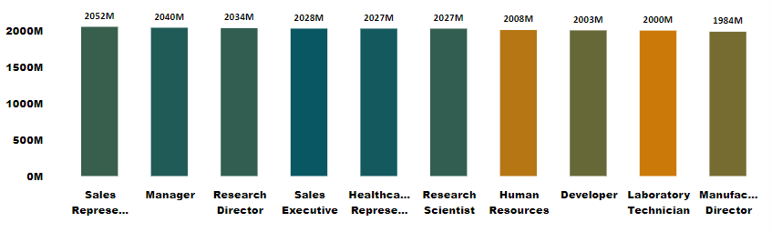
Project analysis slide 5
EXPENSES ANALYSIS
Avg. Daily Rate for Company
Monthly Rate By Distance
799
The monthly rate by distance from the office is displayed in this section.
Avg. Hourly Rate for Company
115
Rate Per Month for Each Designation
Avg. Monthly Rate for Company
404.04k
This displays the organization's average monthly rate.

Slide 11
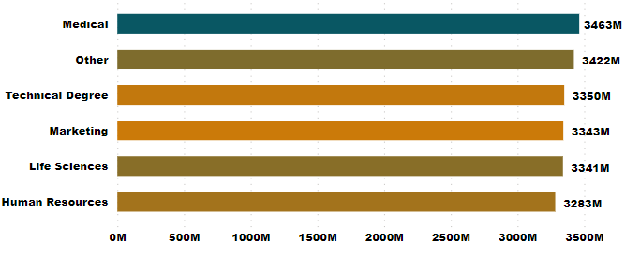
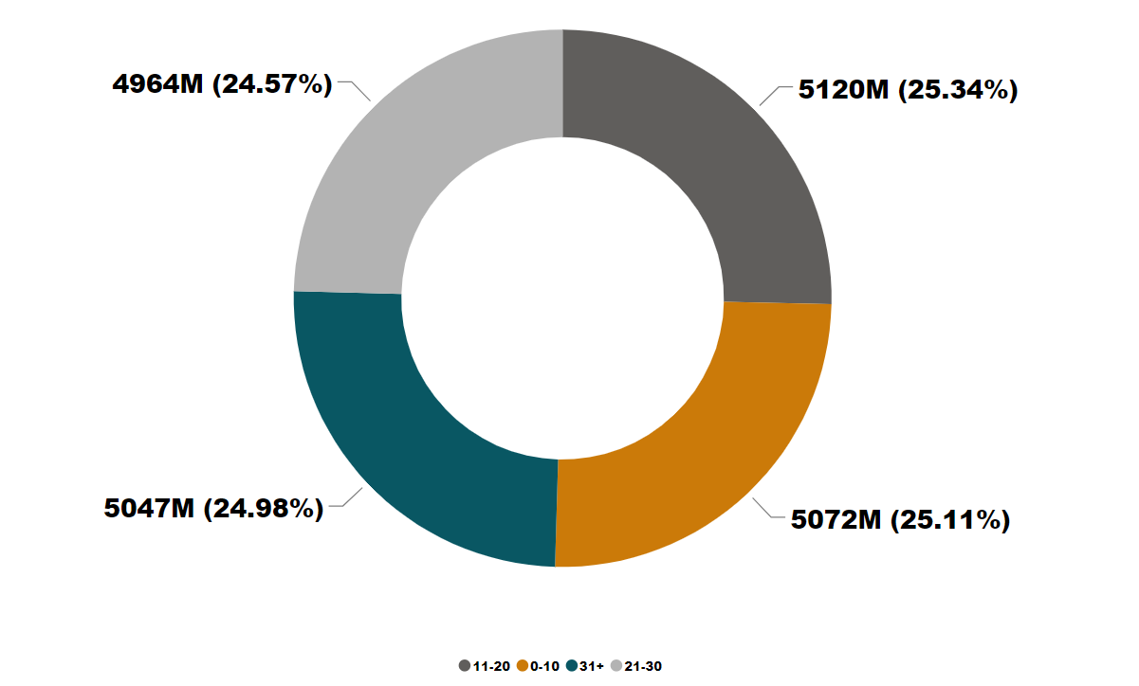
Project analysis slide 10
EXPENSES ANALYSIS
MONTHLY RATE BY EDUCATION FIELD
The monthly rate broken down by Education field is shown in the chart.
MONTHLY RATE BY WORKING YEARS
With respect to working years in the organization, the Donut chart displays the monthly rate and percentage.

Slide 12
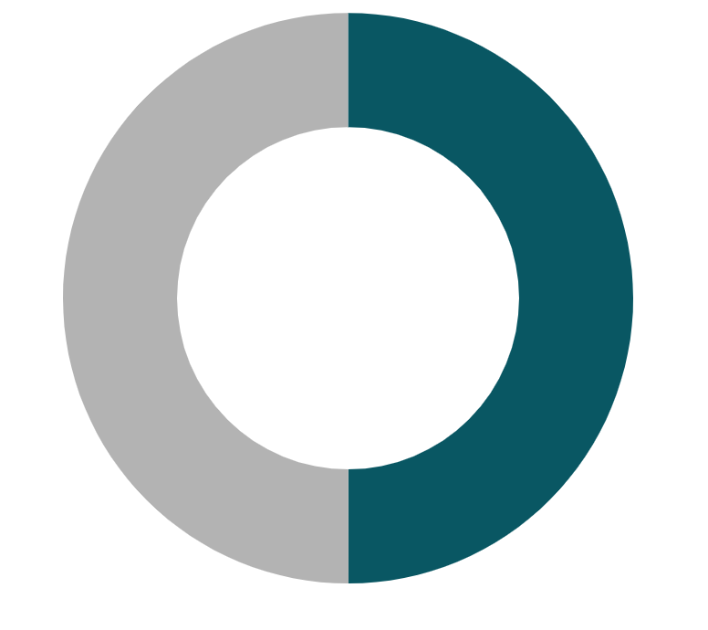

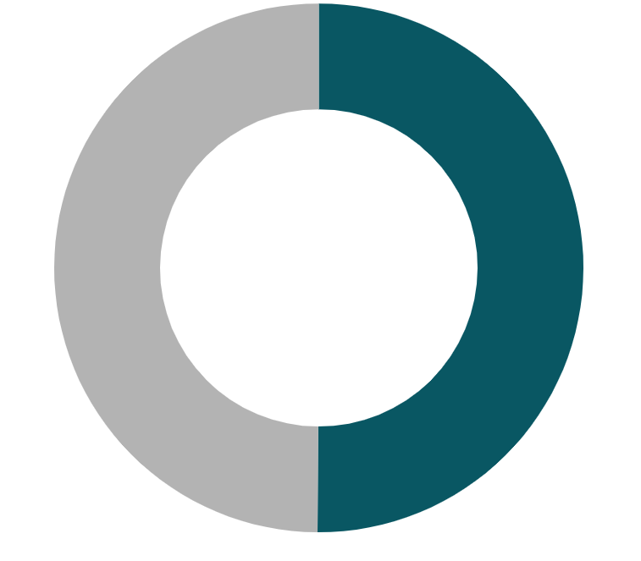
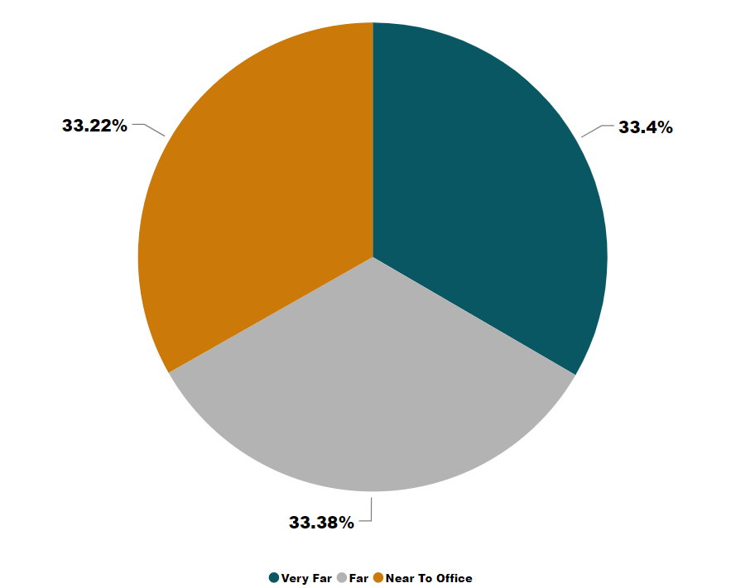
Project analysis slide 10
SALARY HIKE ANALYSIS
This shows the average % increase in wages based on distance.
HARDWARE
SOFTWARE
HR
24.71%
24.71%
24.55%
AVG.HIKE BY DISTANCE
This displays the average percentage of wage increases per department.
Avg. Salary Hike
24.62%
MAX Salary Hike
49.00%

Slide 13
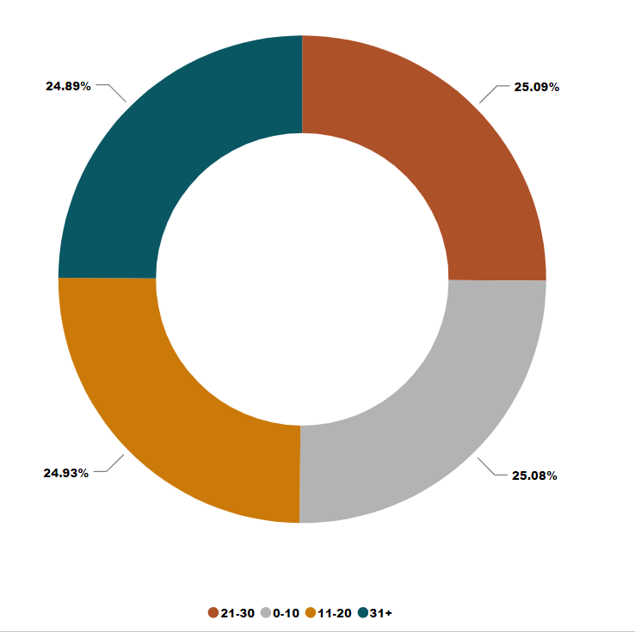
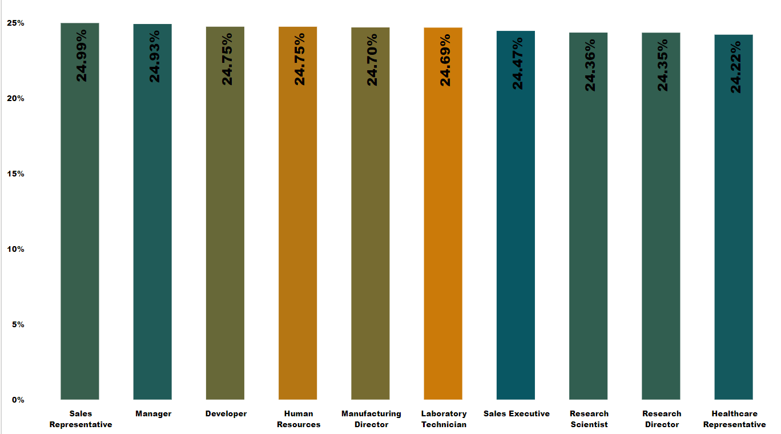
Project analysis slide 10
SALARY HIKE ANALYSIS
AVG. SALARY HIKE BY YEARS WORKING GROUP
The average pay increase by working years is displayed here.
AVG. SALARY HIKE
24.62%
AVG. HIKE BY DESIGNATION
The average pay increase by organizational designation is displayed in this graph.

Slide 14
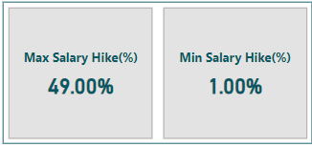
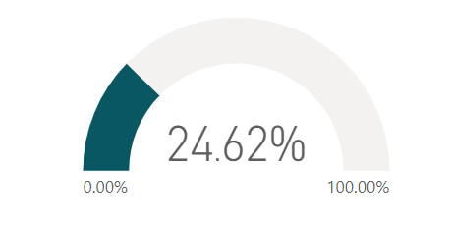
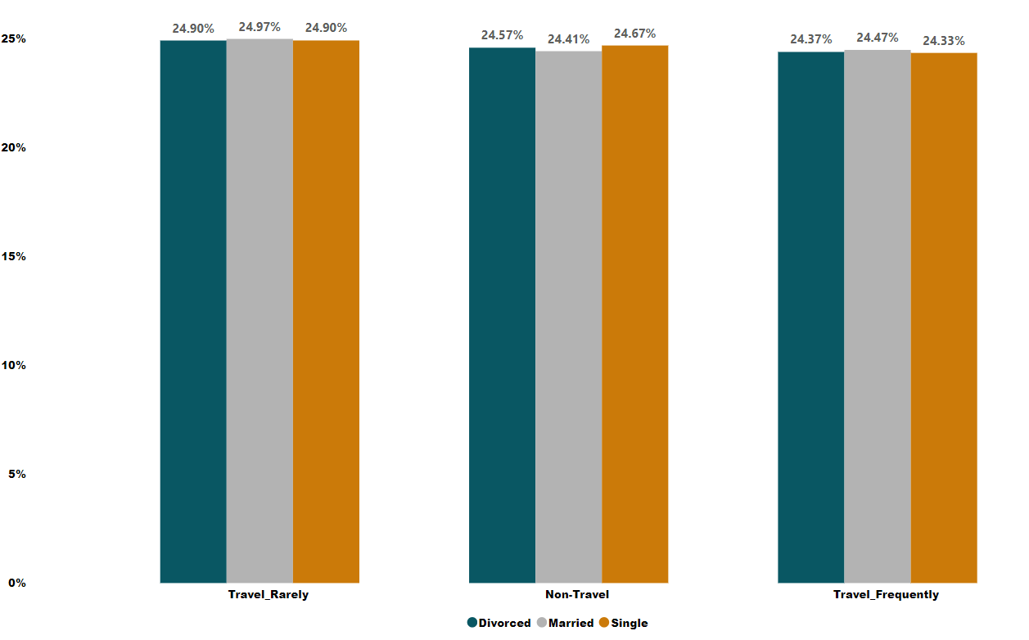
Project analysis slide 10
SALARY HIKE ANALYSIS
AVG. SALARY HIKE
It displays the lowest, maximum, and average salary increase for the organization.
AVG.SALARY HIKE BY TRAVEL / MARITAL STATUS
The average wage increase broken down by marital status and travel is shown in the graph.
Blue color indicates divorce, grey color indicates married, and Orange color indicates single status.

Slide 15
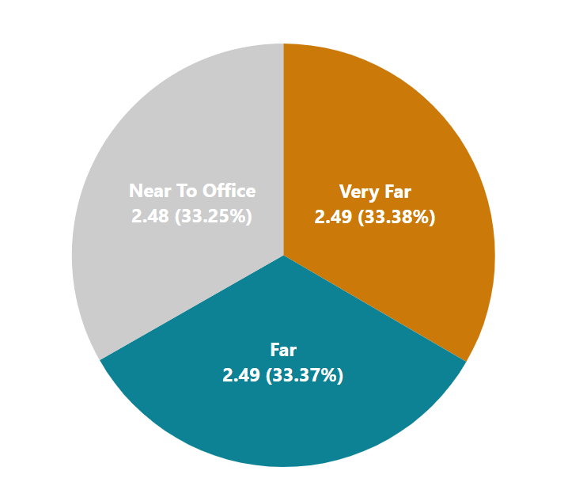
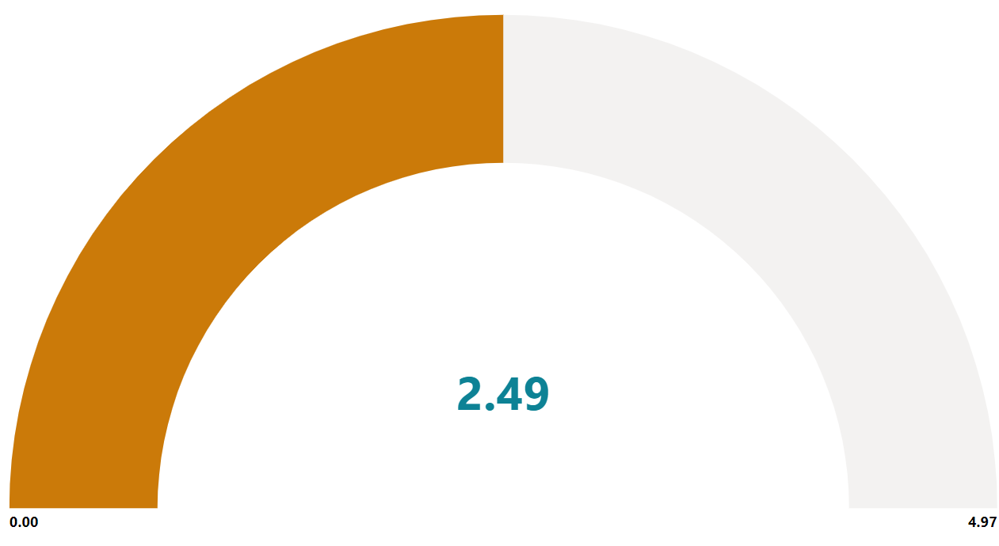
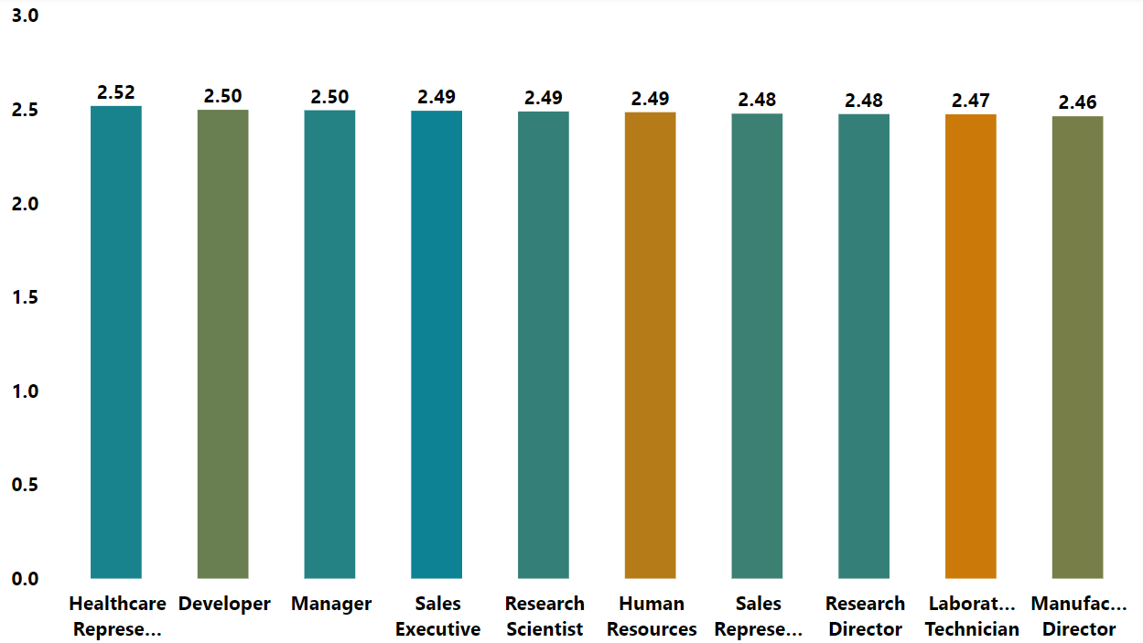
Project analysis slide 10
SATISFACTION ANALYSIS
AVG. JOB SATISFACTION
AVG. JOB SATISFACTION BY DISTANCE
The average job satisfaction rating and percentage are displayed in this section according to the office's distance.
JOB SATISFACTION ON AVG. BY DESIGNATION
The average job satisfaction rating by designation is displayed in this graph.

Slide 16
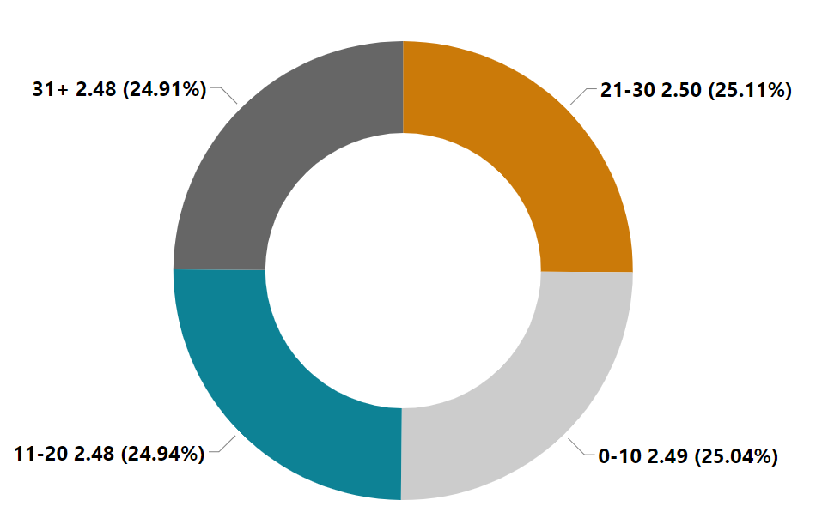
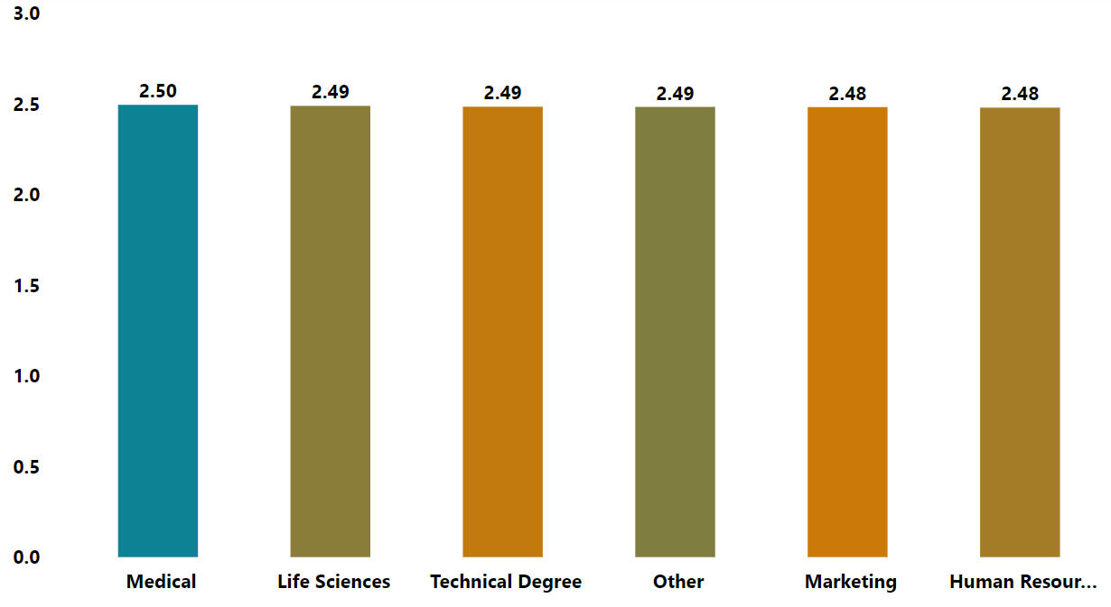
Project analysis slide 10
SATISFACTION ANALYSIS
AVG. JOB SATISFACTION BY WORKING YEARS
This section shows the Average Job satisfaction and percentage of total workers aged 31 and up.
2.49
AVG.
SATISFACTION
AVGERAGE JOB SATISFACTION BY EDUCATION FIELD
The average work satisfaction by education field is displayed on the graph.

Slide 17
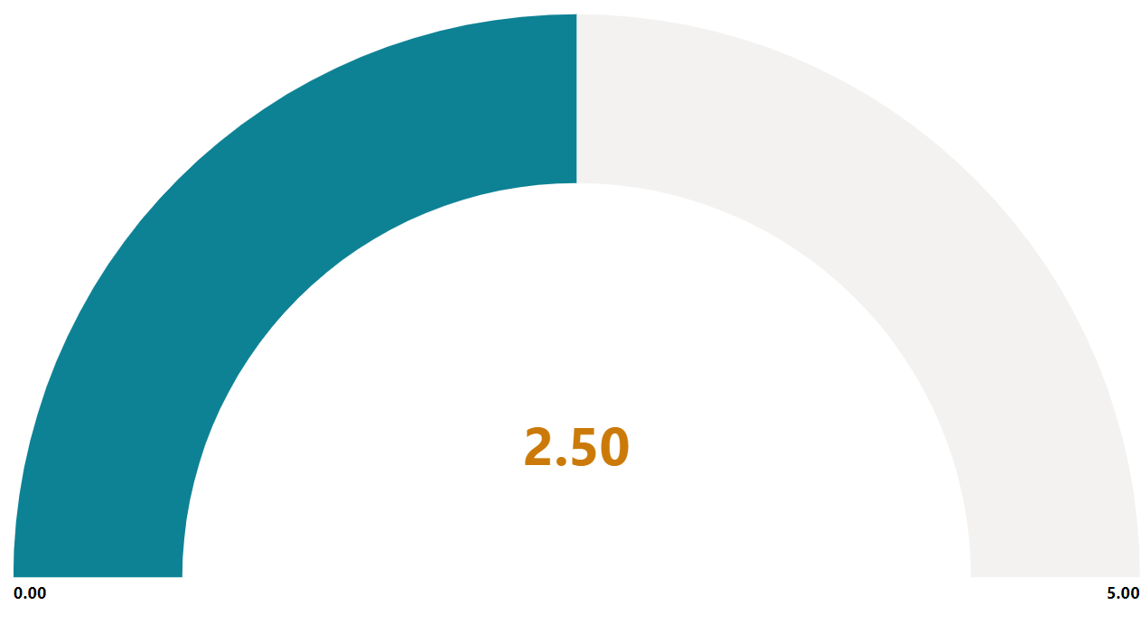
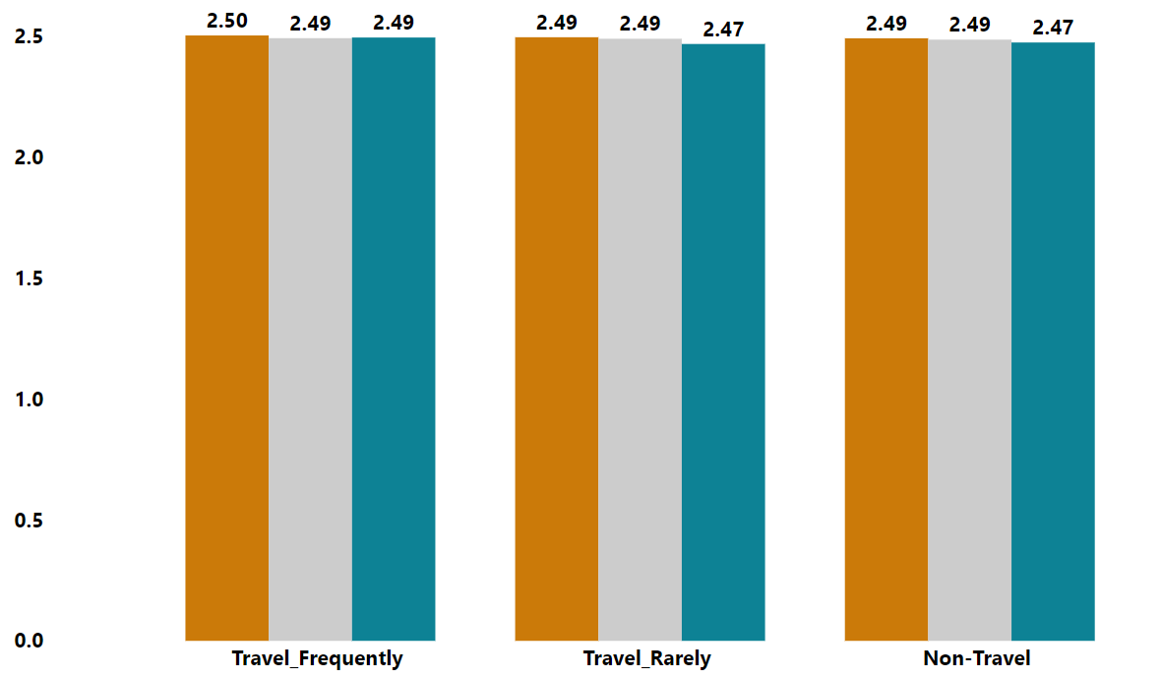
Project analysis slide 10
SATISFACTION ANALYSIS
AVG. JOB SATISFACTION
AVG. ENVIRONMENT SATISFACTION
The gauge chart displays the average level of job satisfaction and environment satisfaction among the workforce.
AVG. JOB SATISFACTION BY TRAVEL / MARITAL STATUS
The average work satisfaction by education field is displayed on the graph..
Orange color indicates divorce, grey color indicates married, and blue color indicates single status.

Slide 18
Project analysis slide 4
SATISFACTION SURVEY
Employees in the company have an average Job Satisfaction rating of 2.48.
JOB
SATISFACTION
Management Objectives
RELATIOSHIP
SATISFACTION
Employees in the company have an average Relationship Satisfaction rating of 2.50
SATISFACTION
SURVEY
ENVIRONMENT
SATISFACTION
Employees in the company have an average Environment Satisfaction rating of 2.49.

Slide 19
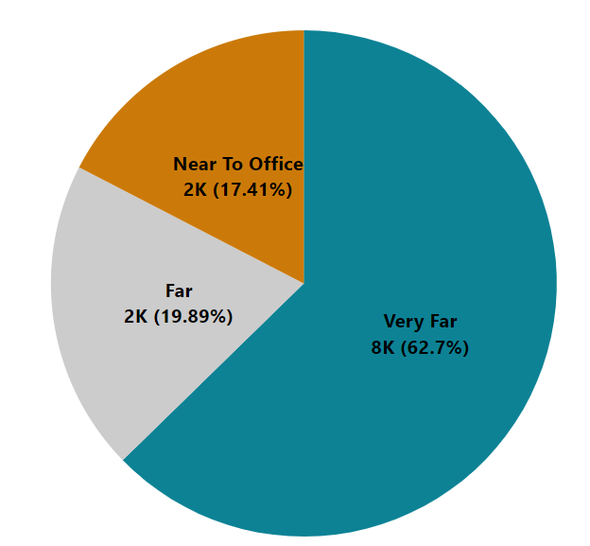
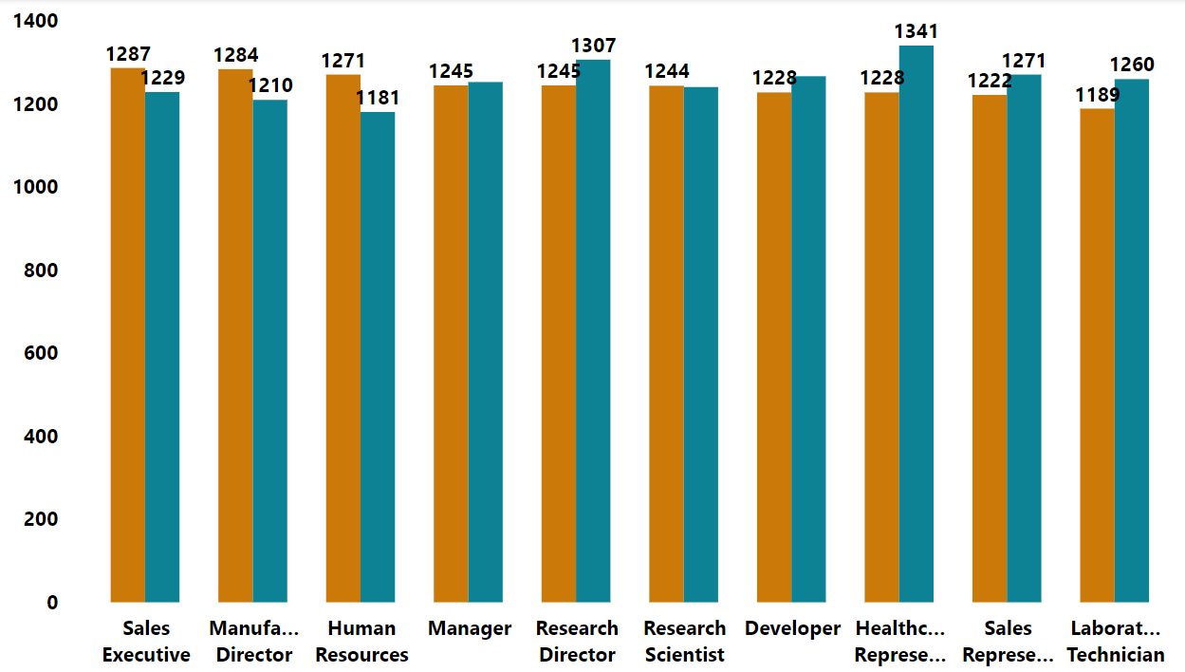
Project analysis slide 10
PERFORMANCE ANALYSIS
BOTTOM RATING COUNT OF WORKERS BY
DISTANCES FROM OFFICE
The number of employees with the lowest ratings and their percentage according to office distance are displayed in the pie chart.
TOP & POOR RATING COUNT BY DESIGNATION
This bar graph displays the number of employees with the top and poor ratings according to their designation.
Orange color indicates Top and Blue color indicates Poor status.

Slide 20
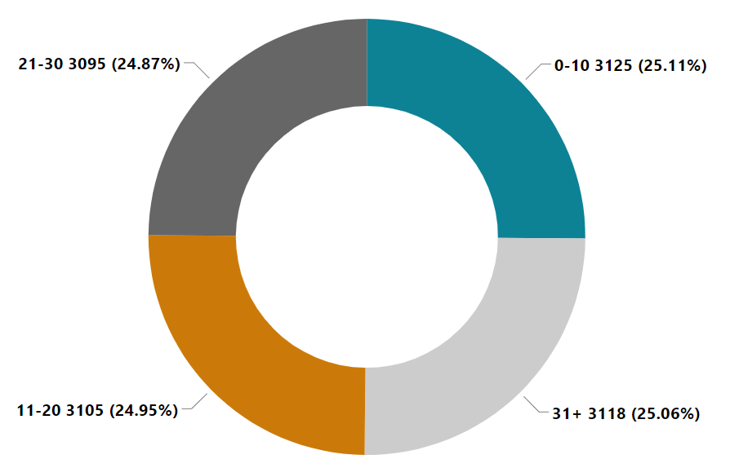
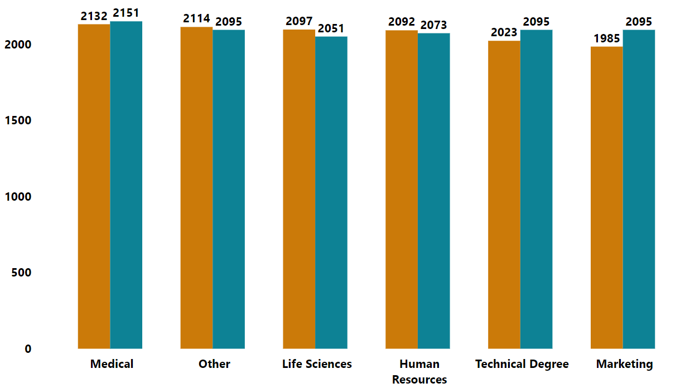
Project analysis slide 10
PERFORMANCE ANALYSIS
HIGHEST-RATING EMPLOYEES BASED ON YEARS OF EMPLOYMENT
The Donut chart displays the number of top-rated employees by years of their employment.
12443
TOP & POOR RATING COUNT BY EDUCATION FIELD
This bar graph displays the number of employees with the top and poor ratings according to their Field of Education.
Orange color indicates Top and Blue color indicates Poor status.

Slide 21
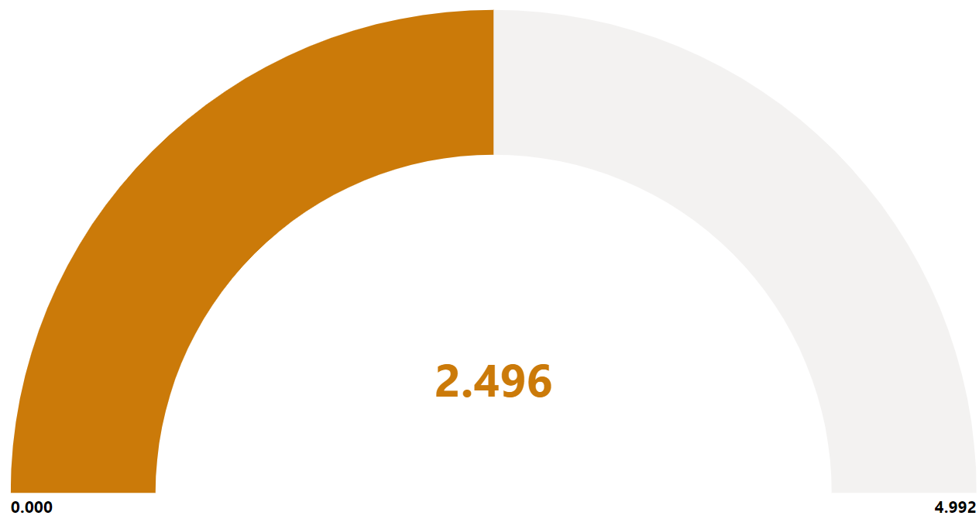
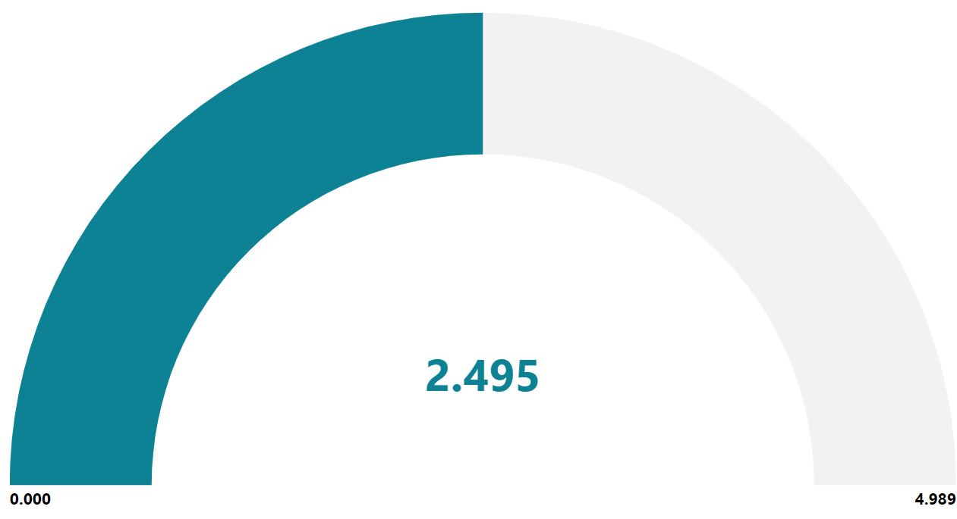
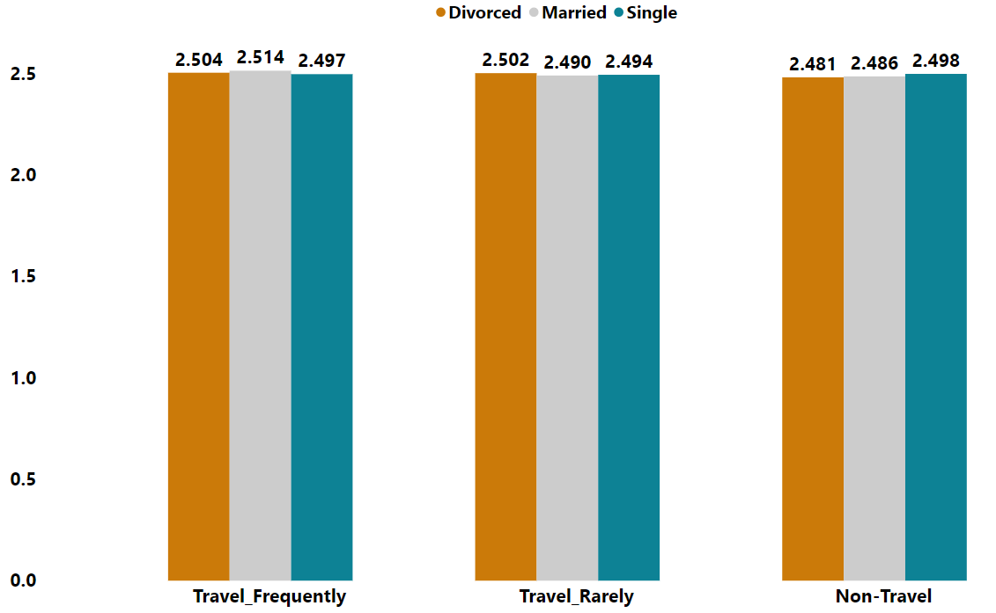
Project analysis slide 10
PERFORMANCE ANALYSIS
AVG. PERFORMANCE RATING
AVG. ACTIVE EMPLOYEES PERFORMANCE
The Gauge chart displays the average employee performance rating as well as the average performance rating of active employees.
AVERAGE PERFORMANCE SCORE
BY MARITAL STATUS AND TRAVEL
The graph displays the average performance rating of employees according to their travel and marital status.
Orange color indicates divorce, grey color indicates married, and blue color indicates single status.

Slide 22
Project analysis slide 4
PERFORMANCE SURVEY
CURRENT
EMPLOYEES
Currently employed staff members have an average performance rating of 2.495 overall.
Management Objectives
PERFORMANCE
SURVEY
RELATIOSHIP
SATISFACTION
EX –
EMPLOYEES
The average performance rating of the former employees is 2.497 overall.

Slide 23
Key Findings
High Attrition Rate:
Implication: A 50% attrition rate is notably high and raises concerns about its impact on productivity, morale, and overall success.
Human Resources Department Dominance:
Implication: The prevalence of HR as the most common department suggests potential workload or staffing imbalances. Analyzing the workload and staffing patterns in this department can help determine if additional support is needed.
Emphasis on Life Sciences(Educational Field):
Implication: The predominance of employees with a Life Sciences background indicates that this field of expertise is highly valued within the organization. This can be advantageous in attracting and retaining talent with specialized knowledge.
Married Employee Majority:
Implication: The majority of employees being married could imply that factors related to family life, such as work-life balance and family commitments, may influence employee retention.

Slide 24
Key Findings
Encourage Gender Equality:
Implication: Equal male-female ratio showcases commitment to gender equality. The Company Encourages women Empowerment.
Low Job Satisfaction Rating:
Implication: The Job Satisfaction rating is comparatively low ie 2.5.
Relationship Satisfaction:
Implication: Diverse levels of relationship satisfaction among employees.

Slide 25
Recommendations
To address the key findings and improve employee retention, consider the following recommendations:
Investigate Attrition Causes:
Conduct exit interviews and surveys to gather insights into the reasons behind employee departures. Analyze the feedback and identify common themes, such as dissatisfaction with work-life balance, lack of growth opportunities, or concerns about compensation and benefits.
Address Workload Imbalance:
Assess the workload and staffing levels in Human Resources. If necessary, consider hiring additional staff to enhance efficiency and reduce the burden on employees.
Leverage Life Sciences Expertise:
Continue to invest in attracting and retaining talent with Life Sciences expertise. This can involve targeted recruitment efforts, offering competitive compensation and benefits, and providing opportunities for professional development in this field.
Promote Work-Life Balance:
Implement policies that support work-life balance, such as flexible work arrangements, family-friendly benefits, and wellness programs. This can help employees manage their personal and professional commitments effectively, contributing to improved job satisfaction and retention.

Slide 26
Recommendations
Employee Engagement and Satisfaction:
Conduct regular surveys or interviews to gather detailed insights into employee satisfaction. Implement programs to enhance overall employee engagement and job satisfaction.

Slide 27
Thank You
GROUP - 6

